Slide 1

Secure Pharmacy Inventory and Prescription Management System with Medicine Stock Tracking
Guided by
Dr. S.K. Saravanan
Presented By
Y. Hema Sai Lahari (192311446) Manasa G (192525315) Kaviyaasri M (192312614)

Slide 2


INTRODUCTION
Manages medicine inventory and patient prescriptions efficiently.
Tracks medicine stock and expiry dates accurately.
Reduces manual errors and paperwork.
Stores data securely using Structures, Arrays, Files, and Strings.
Improves the overall efficiency of pharmacy operations.
The system reduces manual work and improves accuracy.
It provides a secure, fast, and reliable solution for pharmacy operations.

Slide 3
PROBLEM STATEMENT
Manual pharmacy management increases the chances of errors and delays.
Growing demand for faster, secure, and accurate pharmacy services.
Difficulty in tracking medicine stock and expiry dates in real time.
Managing patient prescriptions and inventory records efficiently is challenging.
Need for an automated system to improve accuracy, reduce manual effort, and enhance pharmacy operations.

Slide 4
ABSTRACT
Securely manages pharmacy inventory and prescriptions.
Tracks medicine stock and expiry dates.
Uses Structures, Arrays, Files, and Strings in C.
Reduces manual errors and improves efficiency.
Provides secure and organized data management.

Slide 5
OBJECTIVES
Automate pharmacy inventory management.
Manage patient prescriptions efficiently.
Monitor medicine stock and expiry.
Reduce manual errors.
Improve data security and accuracy.

Slide 6
EXISTING SYSTEM VS PROPOSED SYSTEM
EXISTING SYSTEM | PROPOSED SYSTEM
Manual record maintenance | Automated pharmacy management
Paper-based prescriptions | Digital prescription management
Manual stock updates | Automatic stock tracking
No expiry monitoring | Expiry date alerts
More human errors | Improved accuracy and security
Time-consuming process | Fast and efficient operations

Slide 7
LITERATURE SURVEY
Author & Year | Research Focus | Limitation
Sinha et al. (2025) | Pharmaceutical Inventory Optimization | Focuses mainly on inventory optimization, not prescription management.
JPTCP Survey (2024) | Pharmacy Management System | Limited integration of stock tracking and expiry alerts.
IJSRET (2024) | Pharmacy Inventory & Prescription Management | Limited security and file-based implementation.
Our Proposed System | Secure Pharmacy Inventory & Prescription Management | Integrates inventory, prescriptions, stock monitoring, and expiry tracking in one system using C.

Slide 8
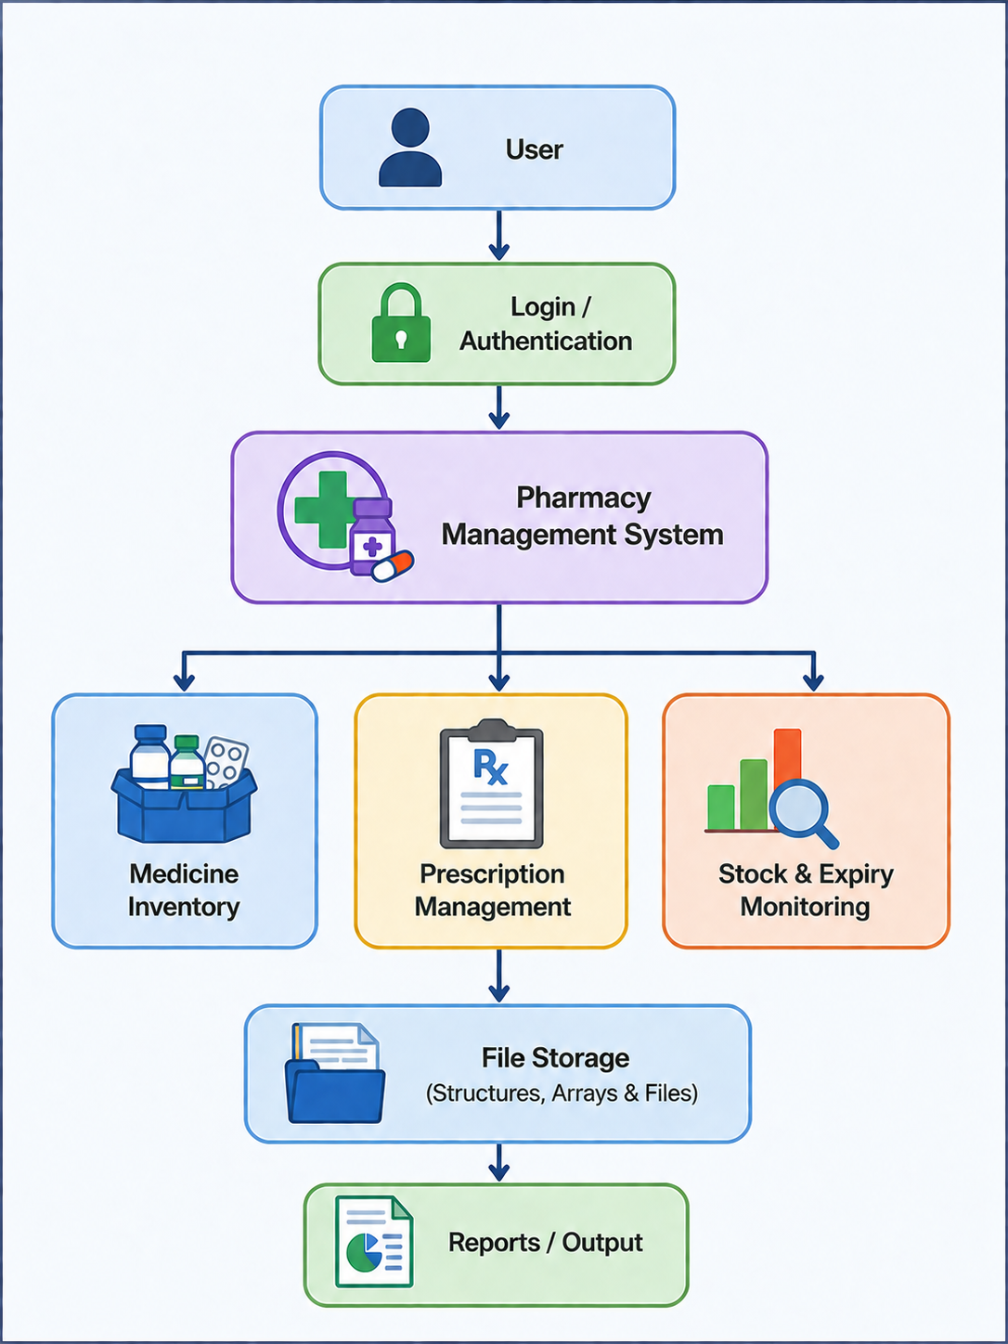
ARCHITECTURE OF THE PROJECT

Slide 9
PROJECT MODULES
Module | Description
Module 1: Medicine Inventory Management | Add, update, search, and delete medicine records. Maintain medicine inventory and availability.
Module 2: Prescription & Patient Medicine Management | Manage patient details, generate prescriptions, assign medicines, and maintain prescription records.
Module 3: Stock & Expiry Monitoring | Monitor stock levels, track expiry dates, identify low-stock medicines, and generate stock reports.

Slide 10
Module 1: Medicine Inventory Management
Purpose: Manage all medicine records in the pharmacy.
Functions:
Add new medicine details.
Update existing medicine information.
Search for a particular medicine using Linear Search.
Delete medicine records.
Store medicine name, ID, quantity, price, etc.
Maintain current medicine availability.
Use Structures, Arrays, Strings, and File Handling for data storage.
Example: If a new medicine Paracetamol arrives, the pharmacist can add its medicine ID, name, quantity, price, and other details to the inventory.

Slide 11
Module 2: Prescription & Patient Medicine Management
Purpose: Manage patient information and their prescriptions.
Functions:
Add and maintain patient details.
Create a prescription for a patient.
Assign medicines to the prescription.
Store prescription records in files.
Search patient or prescription details.
Update prescription information.
Maintain organized patient-medication records.
Example: A patient visits the pharmacy with a prescription. The pharmacist enters the patient's details and adds medicines such as Paracetamol and Azithromycin to the patient's prescription record.

Slide 12
Module 3: Stock & Expiry Monitoring
Purpose: Monitor medicine quantity and expiry dates.
Functions:
Track available medicine stock.
Update stock after medicine sales.
Identify low-stock medicines.
Check medicine expiry dates.
Identify expired medicines.
Generate stock-related reports.
Provide alerts for medicines that need attention.
Example: If Paracetamol stock decreases below the required level, the system identifies it as low stock. If a medicine has passed its expiry date, the system identifies it as expired and prevents its use.

Slide 13
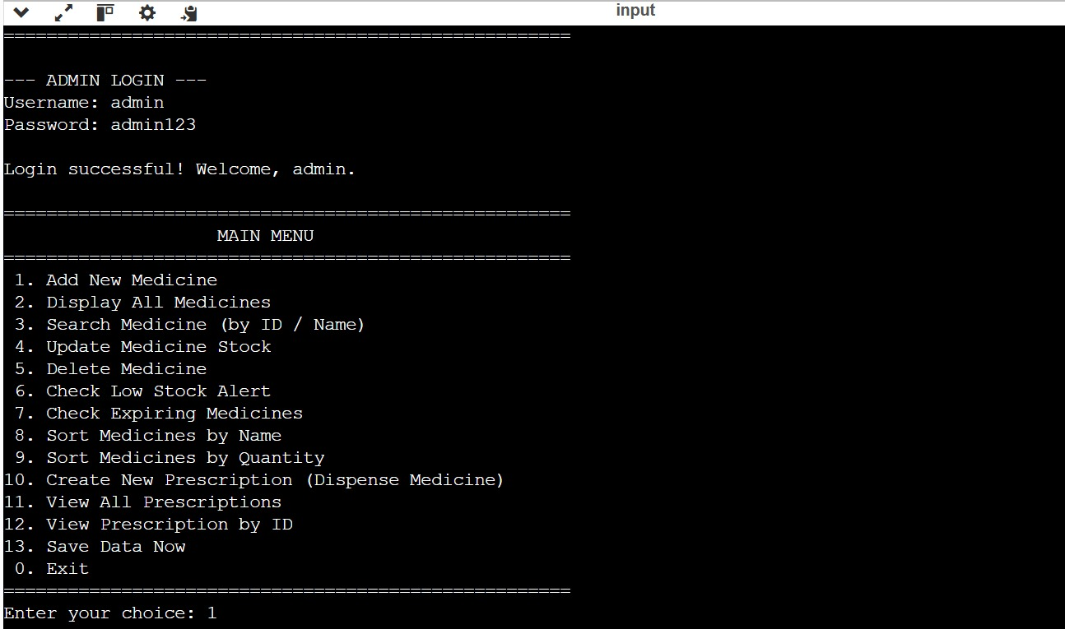

Slide 14
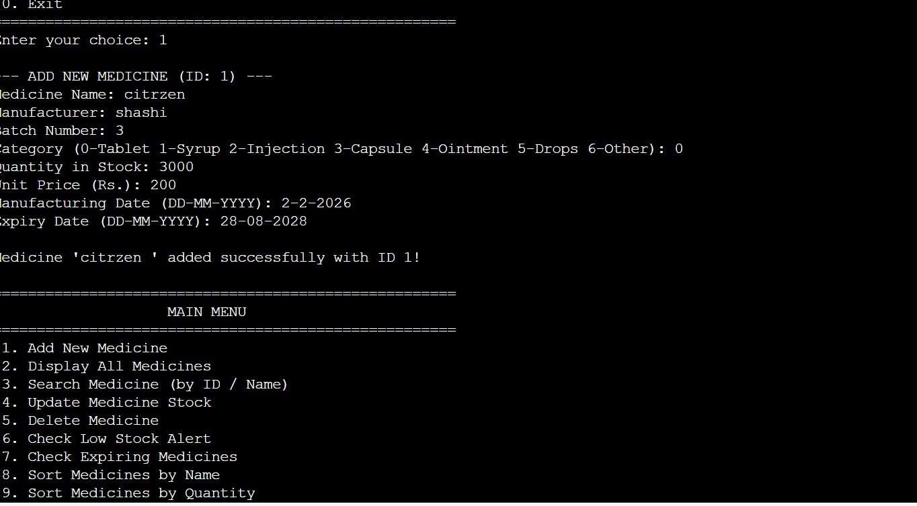

Slide 15
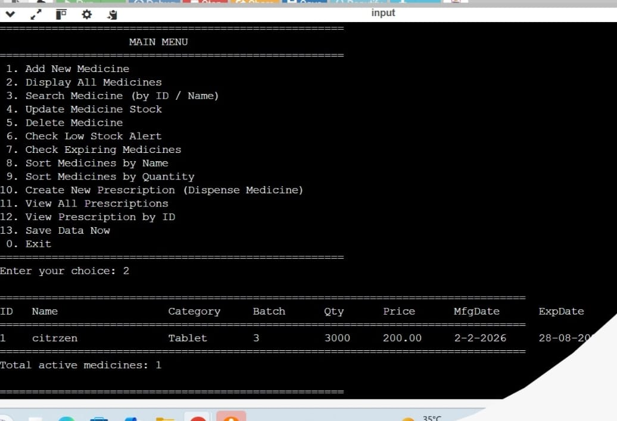

Slide 16
ALGORITHMS
Algorithm | Purpose
Linear Search | Search medicine records
CRUD Operations | Add, Update, Delete records
Stock Update | Update medicine quantity
Expiry Check | Detect expired medicines
File Handling | Store and retrieve data
Data Validation | Validate user inputs

Slide 17
CONCLUSION
Successfully developed a secure pharmacy management system.
Simplified inventory and prescription management.
Improved medicine stock and expiry tracking.
Reduced manual errors and processing time.
Enhanced the efficiency and reliability of pharmacy operations.

Slide 18
ANY QUESTIONS….? 🙂 THANK YOU

